Slide 1
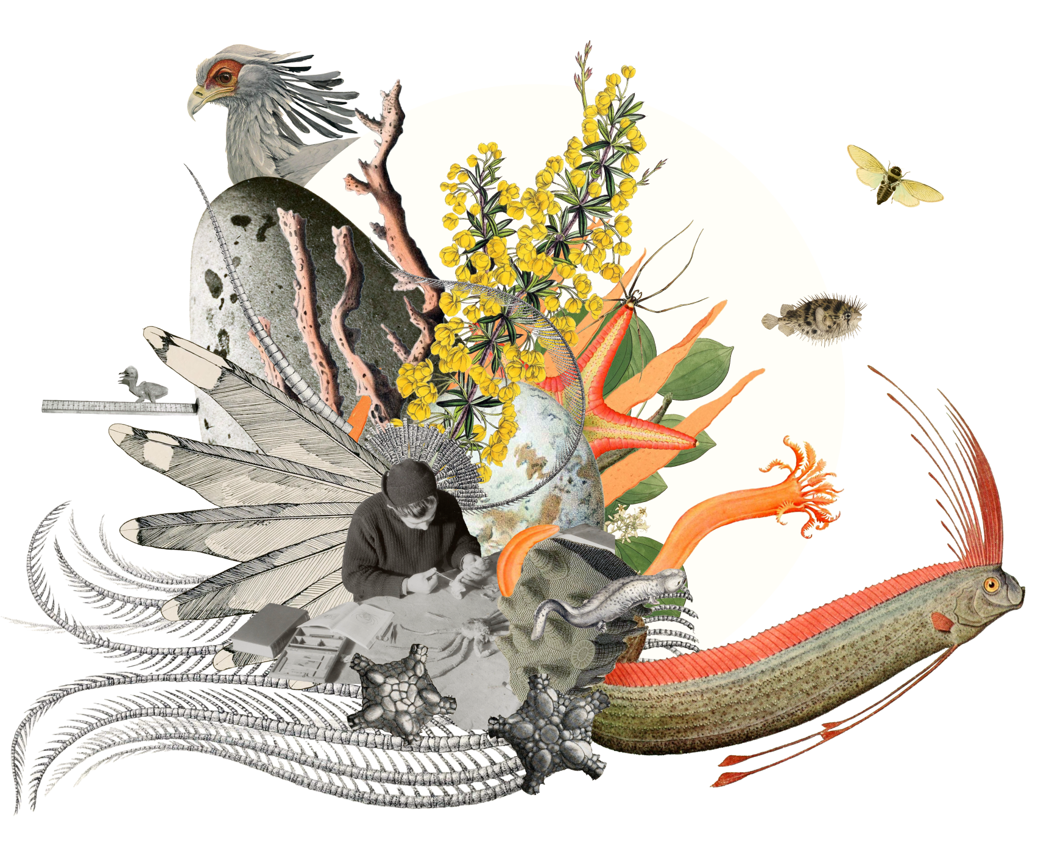
Scientific collections
gbif.org/collections
Notes:
Notes

Slide 2

Scientific collections
Unique sources for shaping our understanding of life on earth
gbif.org/collections
Notes:
Notes

Slide 3
Scientific collections
Whether preserved in natural history museums, herbaria, field stations or laboratories, scientific collections offer invaluable repositories of knowledge that both shape and comprise our understanding of the planet's biodiversity. The vast array of specimens of organisms—both living and preserved—contained in these collections provide insights and connect researchers, institutions, and the public through a vibrant, extensive network.
For those interested in exploring the deep history of life, tracking the impacts of environmental change, or simply learning more about the natural world, the hundreds of millions of specimen records available through the GBIF network provide a gateway into the knowledge residing in scientific collections worldwide.
gbif.org/collections

Slide 4

GRSciColl
The Global Registry of Scientific Collections, or GRSciColl, is a comprehensive, community-curated clearing house of information about the scientific collections that appear in the GBIF registry. Built on GBIF's hosted portal platform, GRSciColl provides access to specimen records and detailed information on physical collections, their host institutions, key contacts, and persistent codes and identifiers.
gbif.org/collections
Notes:
Notes

Slide 5
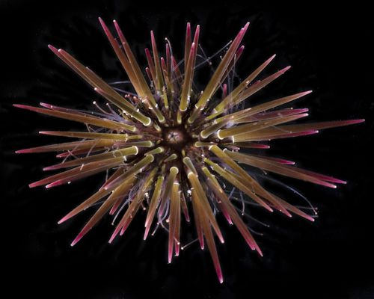
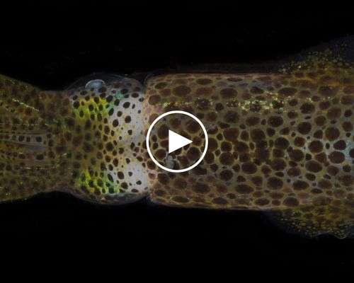
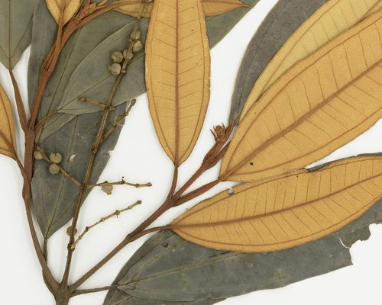
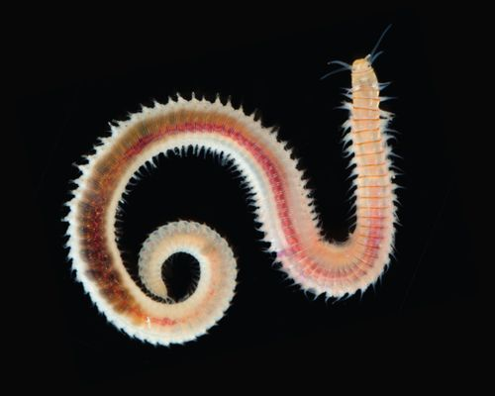
GRSciColl
Explore the new website
▶ Watch these videos to get started
Take part in the community forum
Learn more about the road map
gbif.org/collections
Notes:
Notes

Slide 6
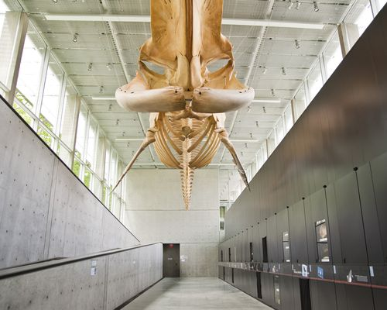



Collections-based hosted portals
Beaty Biodiversity Museum
DiSSCo Flanders
Virtual Herbarium Germany
Natural history collections of the Arctic University Museum of Norway
gbif.org/collections
Notes:
Notes

Slide 7
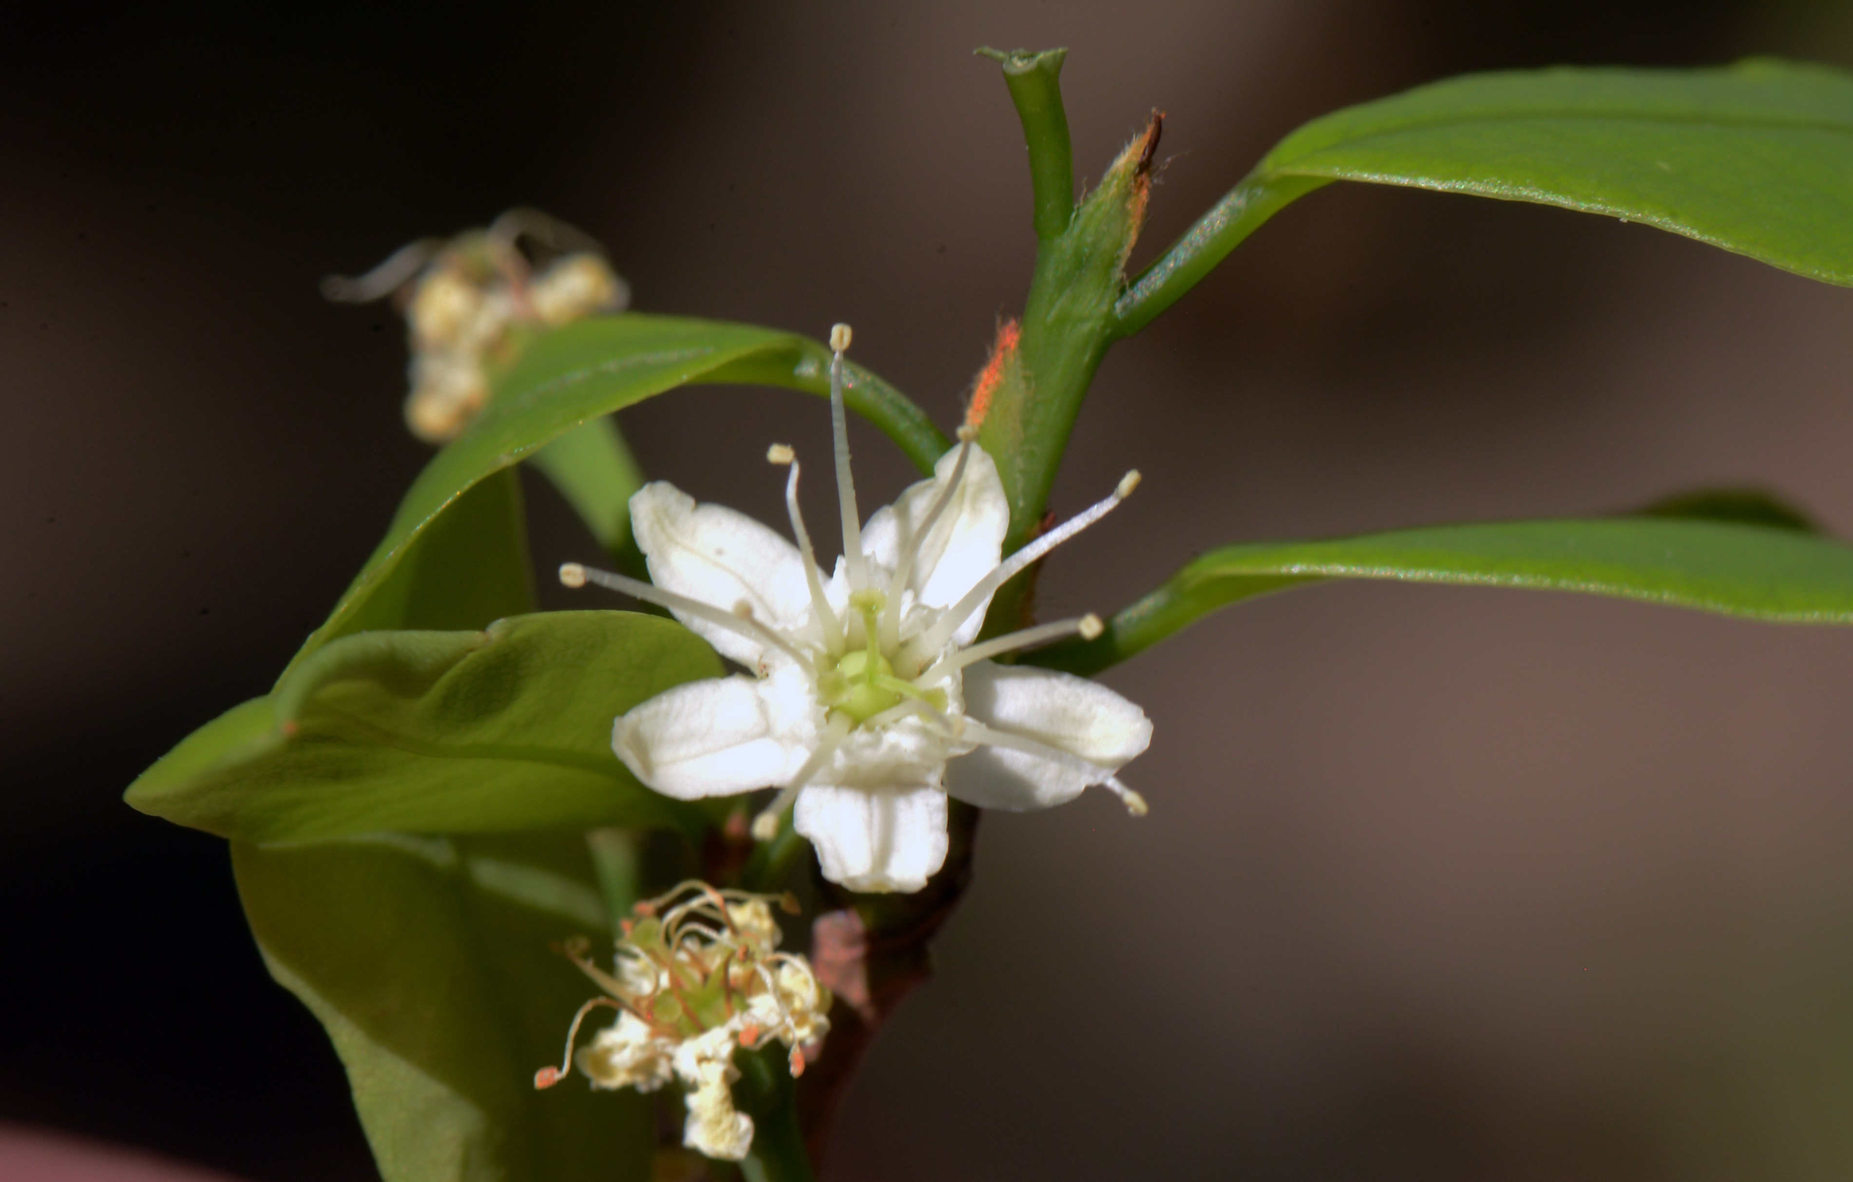
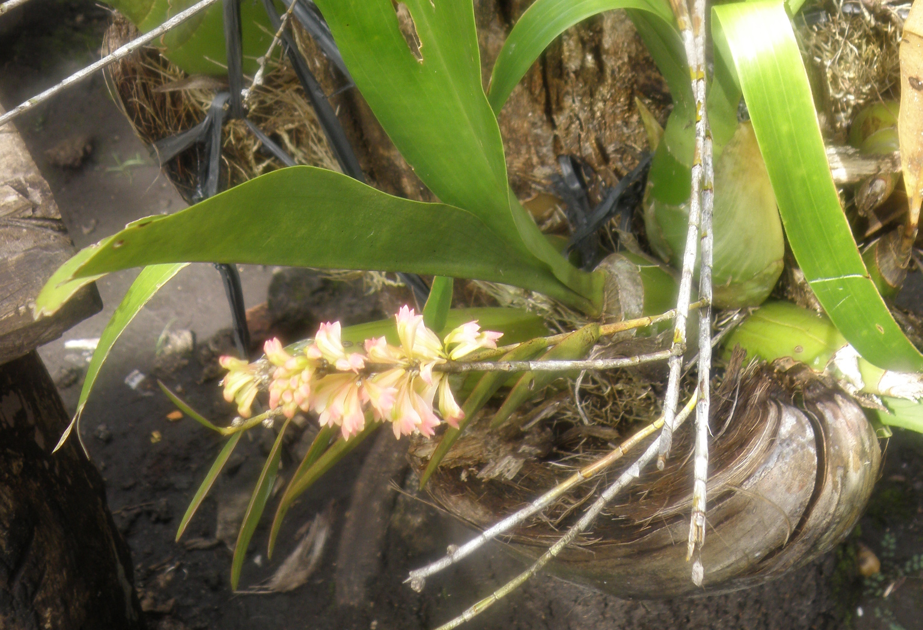
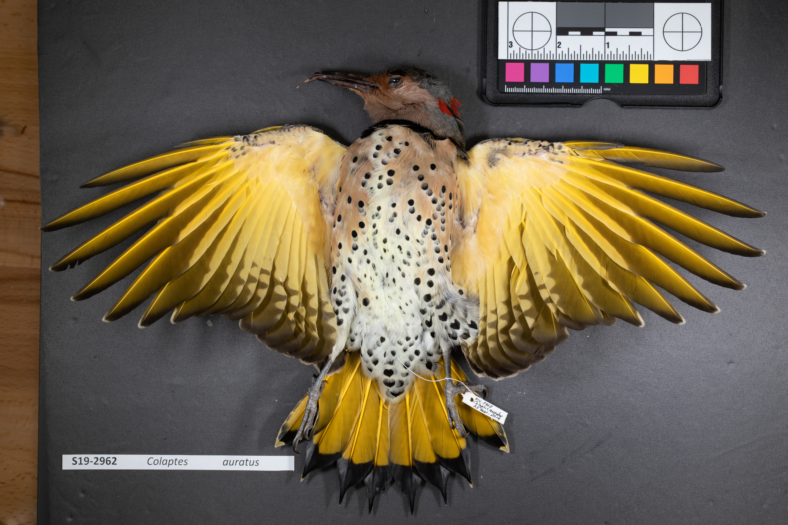
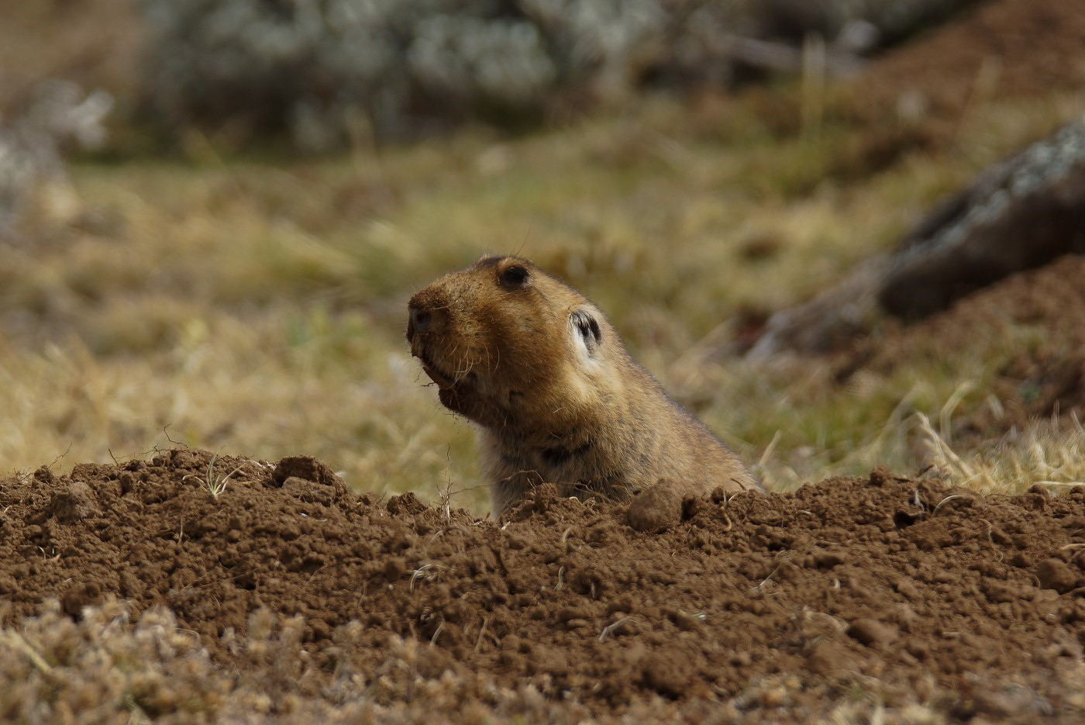
Featured data uses about scientific collections
The colonial legacy of herbaria
Prioritizing conservation of Indonesian medicinal plants
Sex biases in natural history collections
Checklist, taxonomy and distribution of rodents in Ethiopia
gbif.org/collections
Notes:
Notes

Slide 8
Scientific collections
Learn more!
gbif.org/collections

